Slide 1
Graph Algorithms
Group 12:
Bình Gia Huy
Trần Nhật Đức
Đỗ Quốc Duy
Lecturer: Nguyễn Thanh Sơn

Slide 2
Table of Contents:
Why graph?
Graph
Graph Traversal
Shortest-path Algorithms
Topological Sorting

Slide 3
Why graph?
“Many real-world situations can conveniently be described by means of a diagram consisting of a set of points together with lines joining certain pairs of these points.”
- J. A. Bondy and U. S. R. Murty, Graph Theory With Applications
Examples:
Human Relationships
Transportation Networks
Recommendation Systems

Slide 4
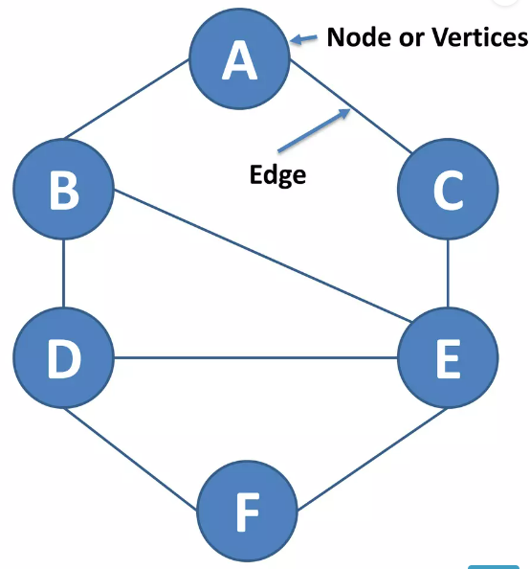
Graph
Graph data structure consists of a finite set of vertices or nodes.
The interconnected objects are represented by points termed as vertices, and the links that connect the vertices are called edges.

Slide 5
Graph
Vertex: Each node of graph is represented as a vertex.
V={A,B,C,D,E,F}
Edge: Edge represents a path between two vertices or a line between two vertices.
E={AB,AC,BD,BE,CE,DE,DF,EF}

Slide 6
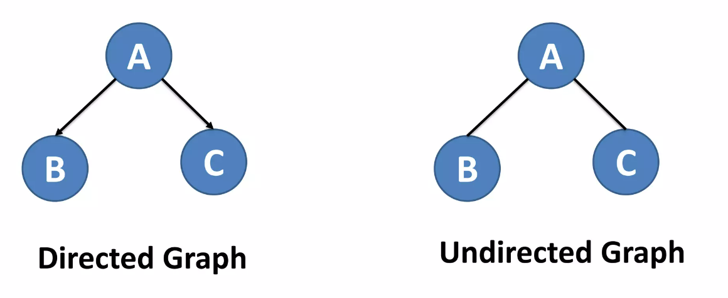
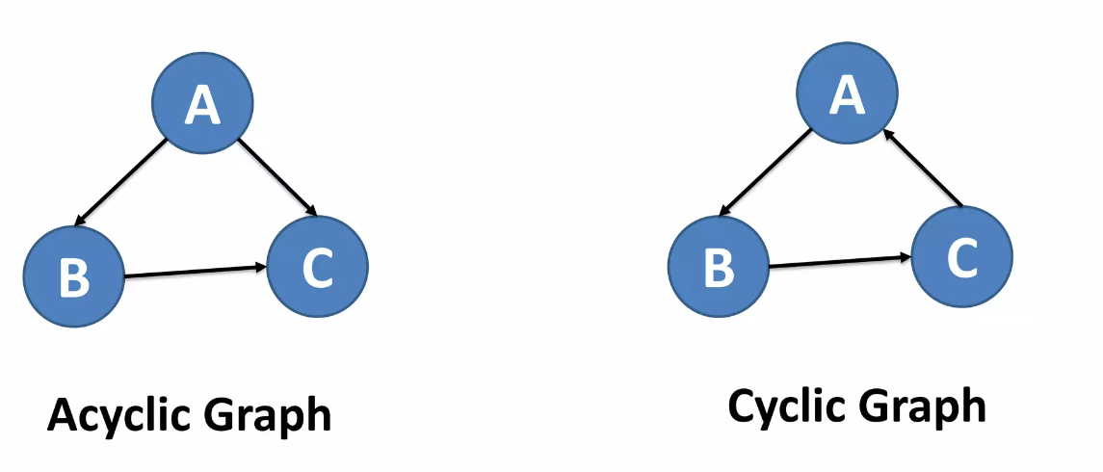
Graph

Slide 7


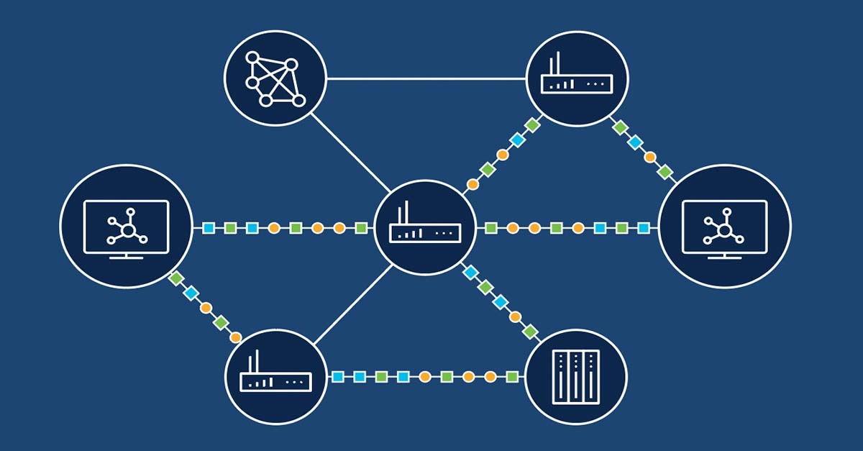
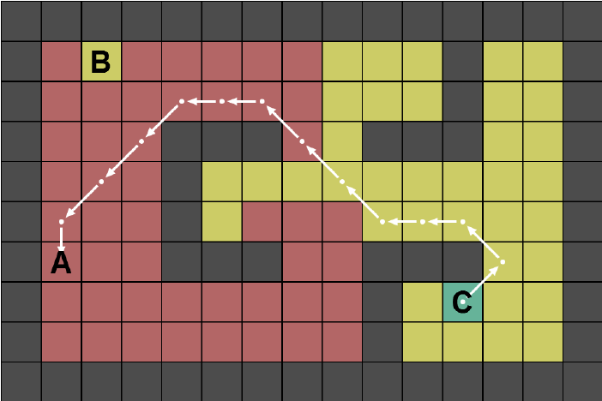
Graph Traversal
Applications
Web Crawling and Search Engines
Social Networks
Routing in Computer Networks
Pathfinding

Slide 8
Graph Traversal
Breadth First Search Traversal
The breadth-first search (BFS) algorithm starts at the tree’s root or graph and searches/visits all nodes at the current depth level before moving on to the nodes at the next depth level. Breadth-first search can be used to solve many problems in graph theory.
BFS follows the Exhaustive Search approach.
BFS algorithm
A standard BFS implementation puts each vertex of the graph into one of two categories:
1. Visited
2. Not Visited
The purpose of the algorithm is to mark each vertex as visited while avoiding cycles.

Slide 9
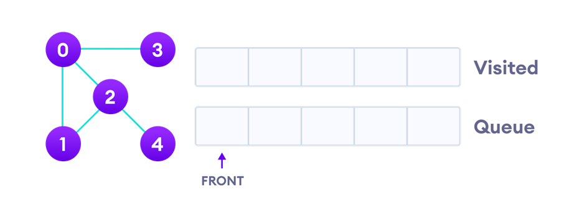
Graph Traversal
BFS example
We use an undirected graph with 5 vertices.

Slide 10
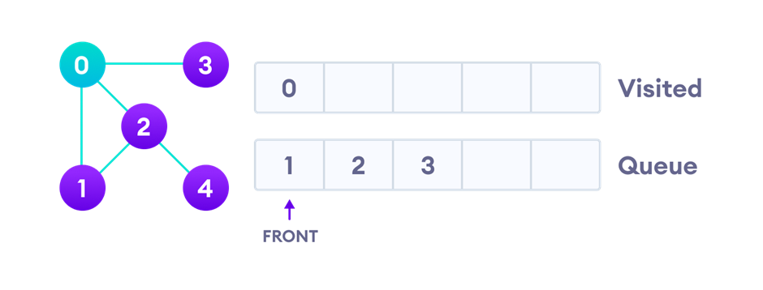
Graph Traversal
BFS example
We start from vertex 0, the BFS algorithm starts by putting it in the Visited list and putting all its adjacent vertices in the queue.

Slide 11
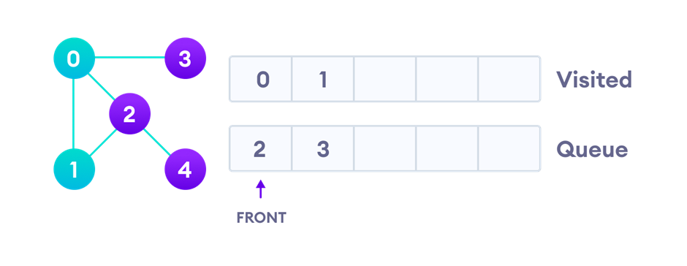
Graph Traversal
BFS example
Next, we visit the element at the front of queue i.e. 1 and go to its adjacent nodes. Since 0 has already been visited, we visit 2 instead.

Slide 12
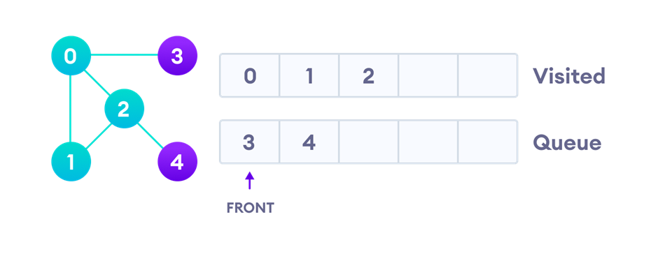
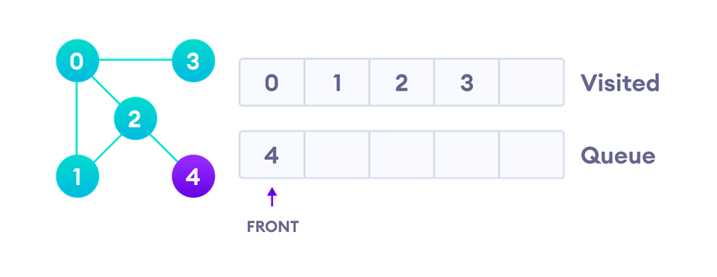
Graph Traversal
Vertex 2 has an unvisited adjacent vertex in 4, so we add that to the back of the queue and visit 3, which is at the front of the queue.
BFS example

Slide 13
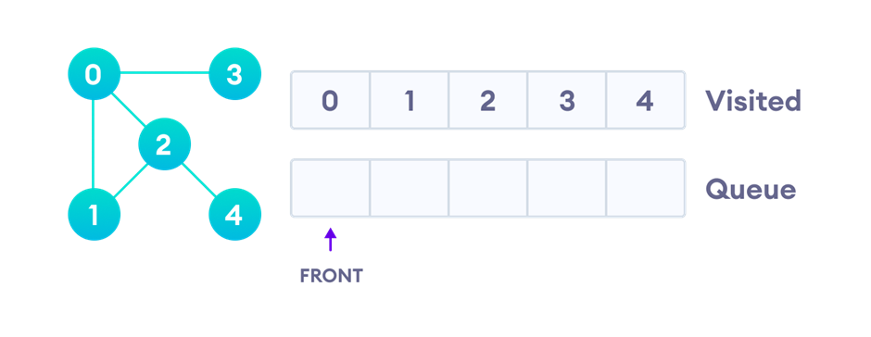
Graph Traversal
BFS example
Only 4 remains in the queue since the only adjacent node of 3 i.e. 0 is already visited. We visit it.
Since the queue is empty, we have completed the Breadth First Traversal of the graph.

Slide 14
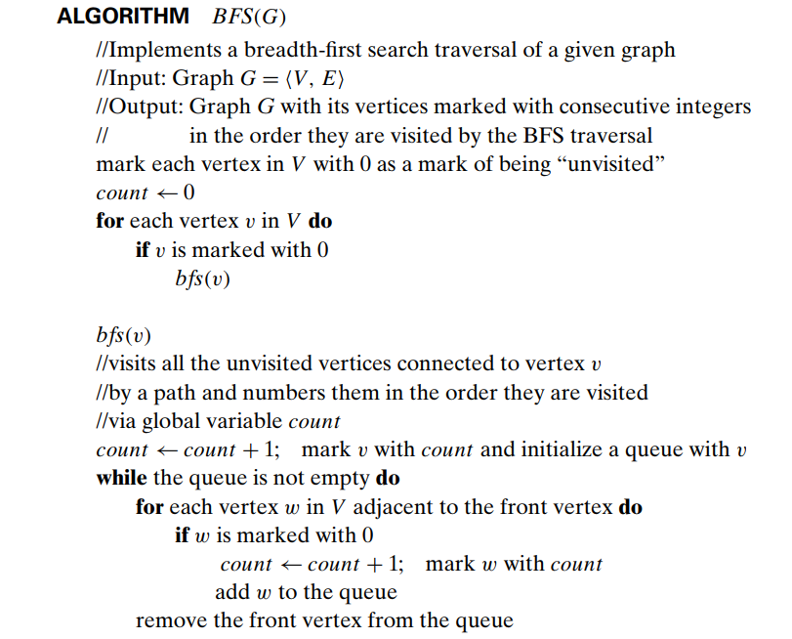
Graph Traversal

Slide 15
Graph Traversal
BFS Algorithm Complexity
The time complexity of the BFS algorithm is represented in the form of O(V+E), where V is the number of nodes and E is the number of edges.
The space complexity of the algorithm is O(V).

Slide 16
Graph Traversal
Advantages/Disadvantages:
Advantages
Will find a solution if there is one
Simple
Disadvantages
Memory requirements
Can be slow

Slide 17
Graph Traversal
Depth First Search Traversal
The Depth-first search (DFS) algorithm starts at the root (top) node of a tree and goes as far as it can down a given branch (path), then backtracks until it finds an unexplored path, and then explores it. The algorithm does this until the entire graph has been explored.
DFS is also an exhaustive search algorithm.
DFS algorithm
A standard DFS implementation puts each vertex of the graph into one of two categories:
1. Visited
2. Not Visited
The purpose of the algorithm is to mark each vertex as visited while avoiding cycles.

Slide 18
Graph Traversal
DFS example
We use an undirected graph with 5 vertices.

Slide 19
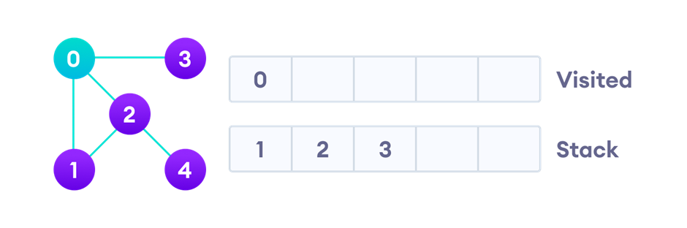
Graph Traversal
DFS example
We start from vertex 0, the DFS algorithm starts by putting it in the Visited list and putting all its adjacent vertices in the stack.

Slide 20
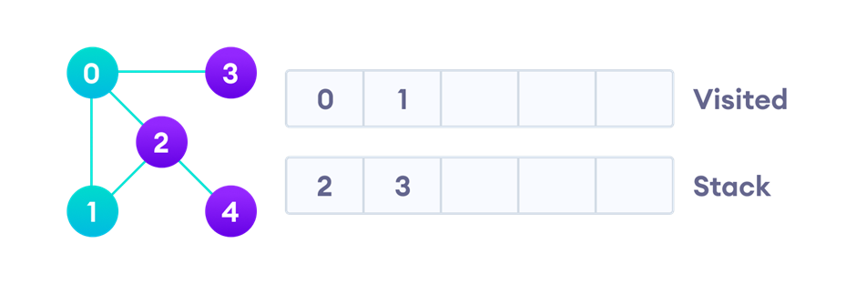
Graph Traversal
DFS example
Next, we visit the element at the top of stack i.e. 1 and go to its adjacent nodes. Since 0 has already been visited, we visit 2 instead.

Slide 21
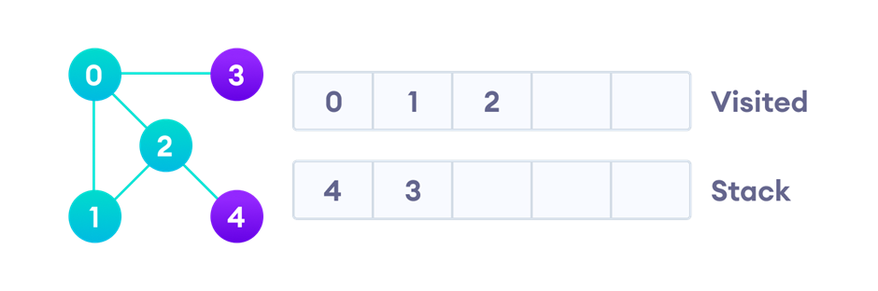
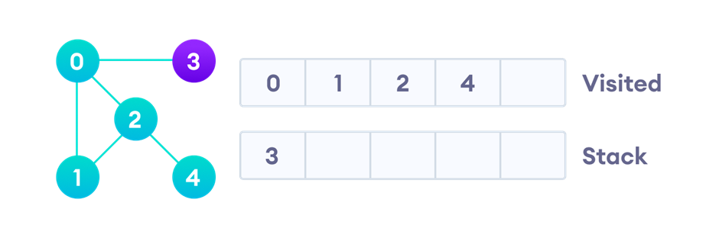
Graph Traversal
DFS example
Vertex 2 has an unvisited adjacent vertex in 4, so we add that to the top of the stack and visit it.

Slide 22
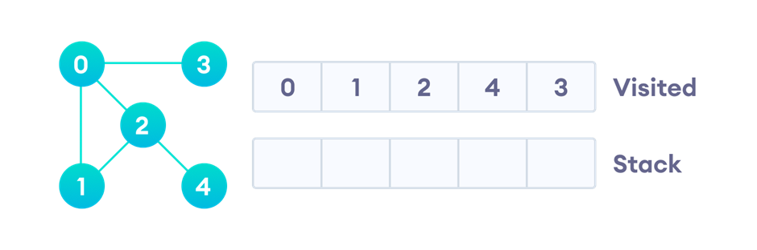
Graph Traversal
DFS example
After we visit the last element 3, it doesn't have any unvisited adjacent nodes, so we have completed the Depth First Traversal of the graph.

Slide 23
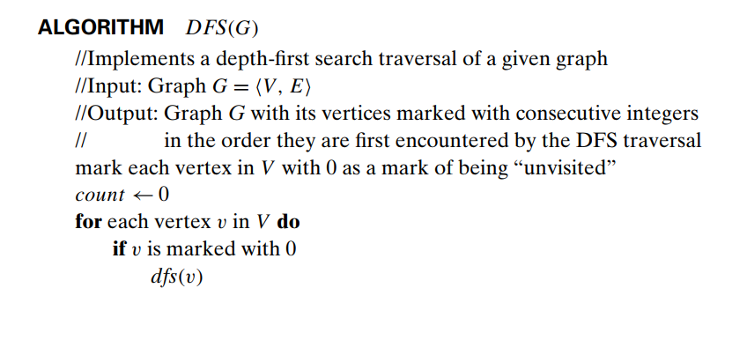
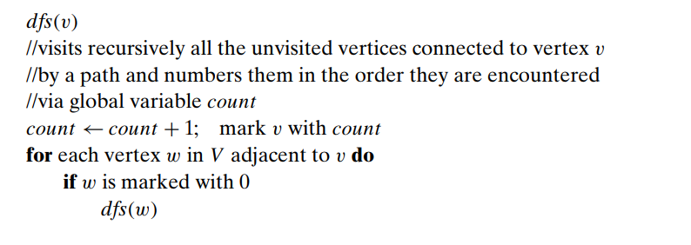
Graph Traversal
DFS Pseudocode
Crawlers in Search Engines

Slide 24
Graph Traversal
Complexity of Depth First Search
The time complexity of the DFS algorithm is represented in the form of O(V+E), where V is the number of nodes and E is the number of edges.
The space complexity of the algorithm is O(V).

Slide 25
Graph Traversal
Advantages/Disadvantages:
Advantages
Consumes less memory than DFS
It will reach at the goal node in a less time period than BFS if it traverses in a right path.
Simple
Disadvantages
May enter infinite loops
No guarantee of finding an optimal solution if there is more than one solution

Slide 26
Shortest-path Algorithms
Floyd-Warshall Algorithm
Floyd-Warshall Algorithm is an algorithm with the main idea of gradually building up all intermediate vertices between vertices i and j to find the optimal path.
This algorithm follows the dynamic programming approach.

Slide 27



Shortest-path Finding
Applications
Flight and Travel Planning
Supply Chain Management
Urban Planning

Slide 28
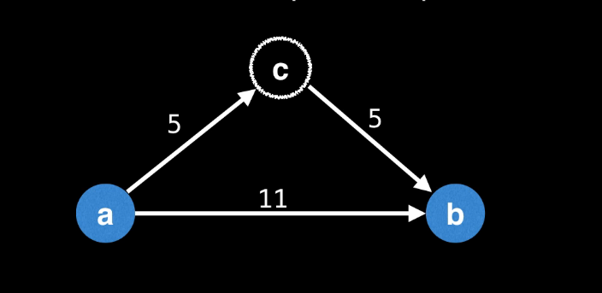
Shortest-path Algorithms
If m[a][c] + m[c][b] > m[a][b] => It’s better to go through c!

Slide 29
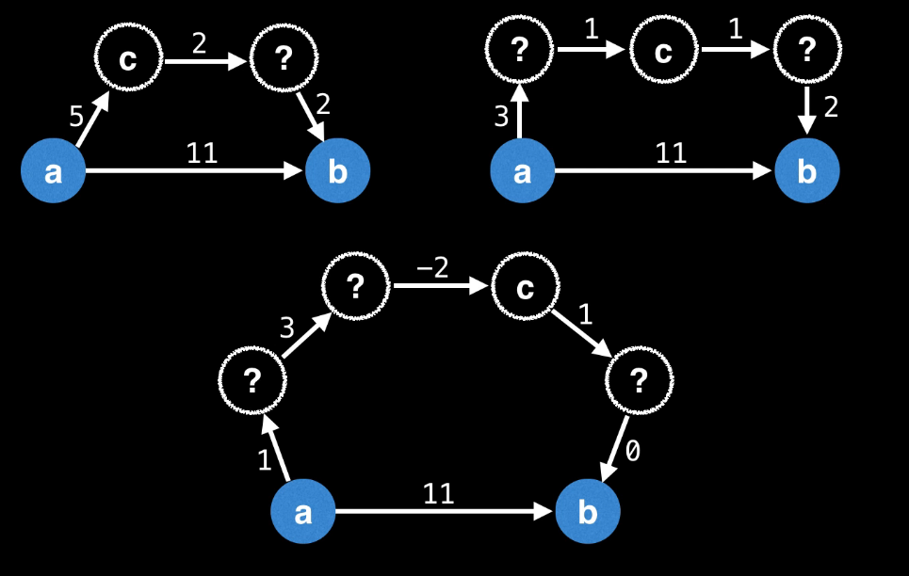
Shortest-path Algorithms
dp[i][j] = min(dp[i][j], dp[i][k] + dp[k][j])

Slide 30
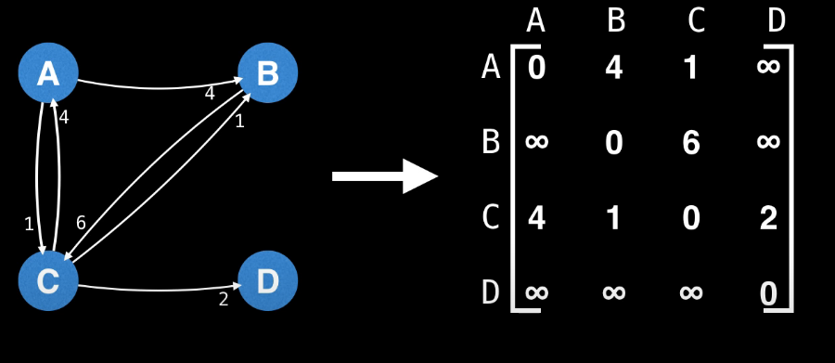
Shortest-path Algorithms

Slide 31
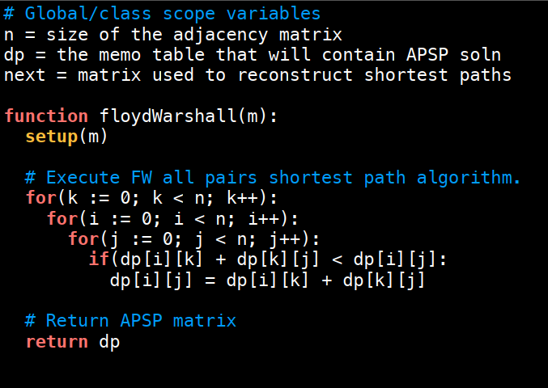
Shortest-path Algorithms
FWA Pseudocode

Slide 32
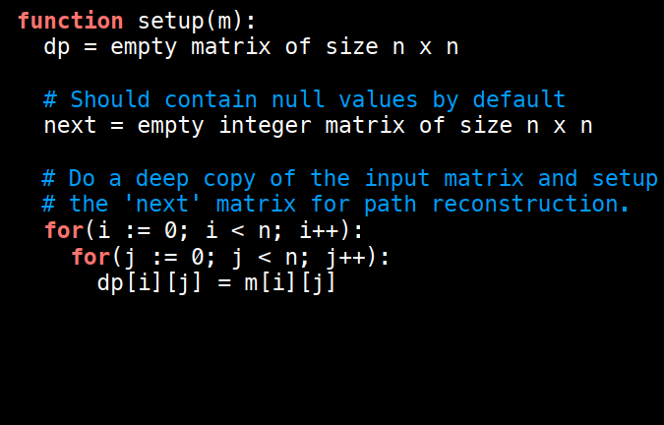
Shortest-path Algorithms
FWA Pseudocode

Slide 33
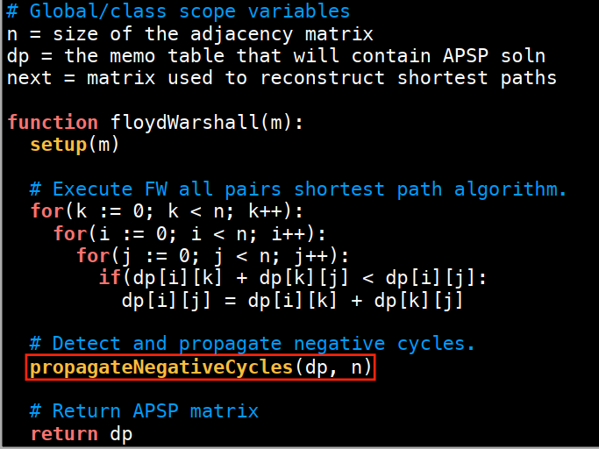
Shortest-path Algorithms
FWA Pseudocode

Slide 34
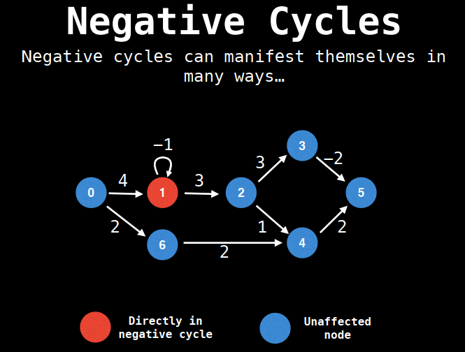
Shortest-path Algorithms
FWA Pseudocode

Slide 35
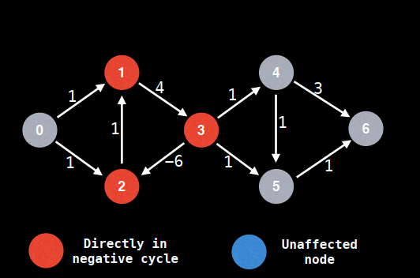
Shortest-path Algorithms
FWA Pseudocode

Slide 36
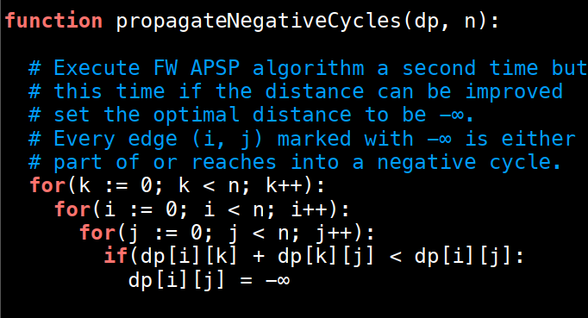
Shortest-path Algorithms
FWA Pseudocode

Slide 37
Shortest-path Algorithms
Floyd-Warshall Algorithm's Complexity
Time Complexity
There are three loops, each loop has constant complexities. So, the time complexity of the Floyd-Warshall algorithm is O(V^3).
Space Complexity
The space complexity of the Floyd-Warshall algorithm is O(V^2).

Slide 38
Shortest-path Algorithms
Advantages/Disadvantages:
Advantages
Simple
Versatile
Efficient for small graphs
Disadvantages
Inefficient for large graphs

Slide 39
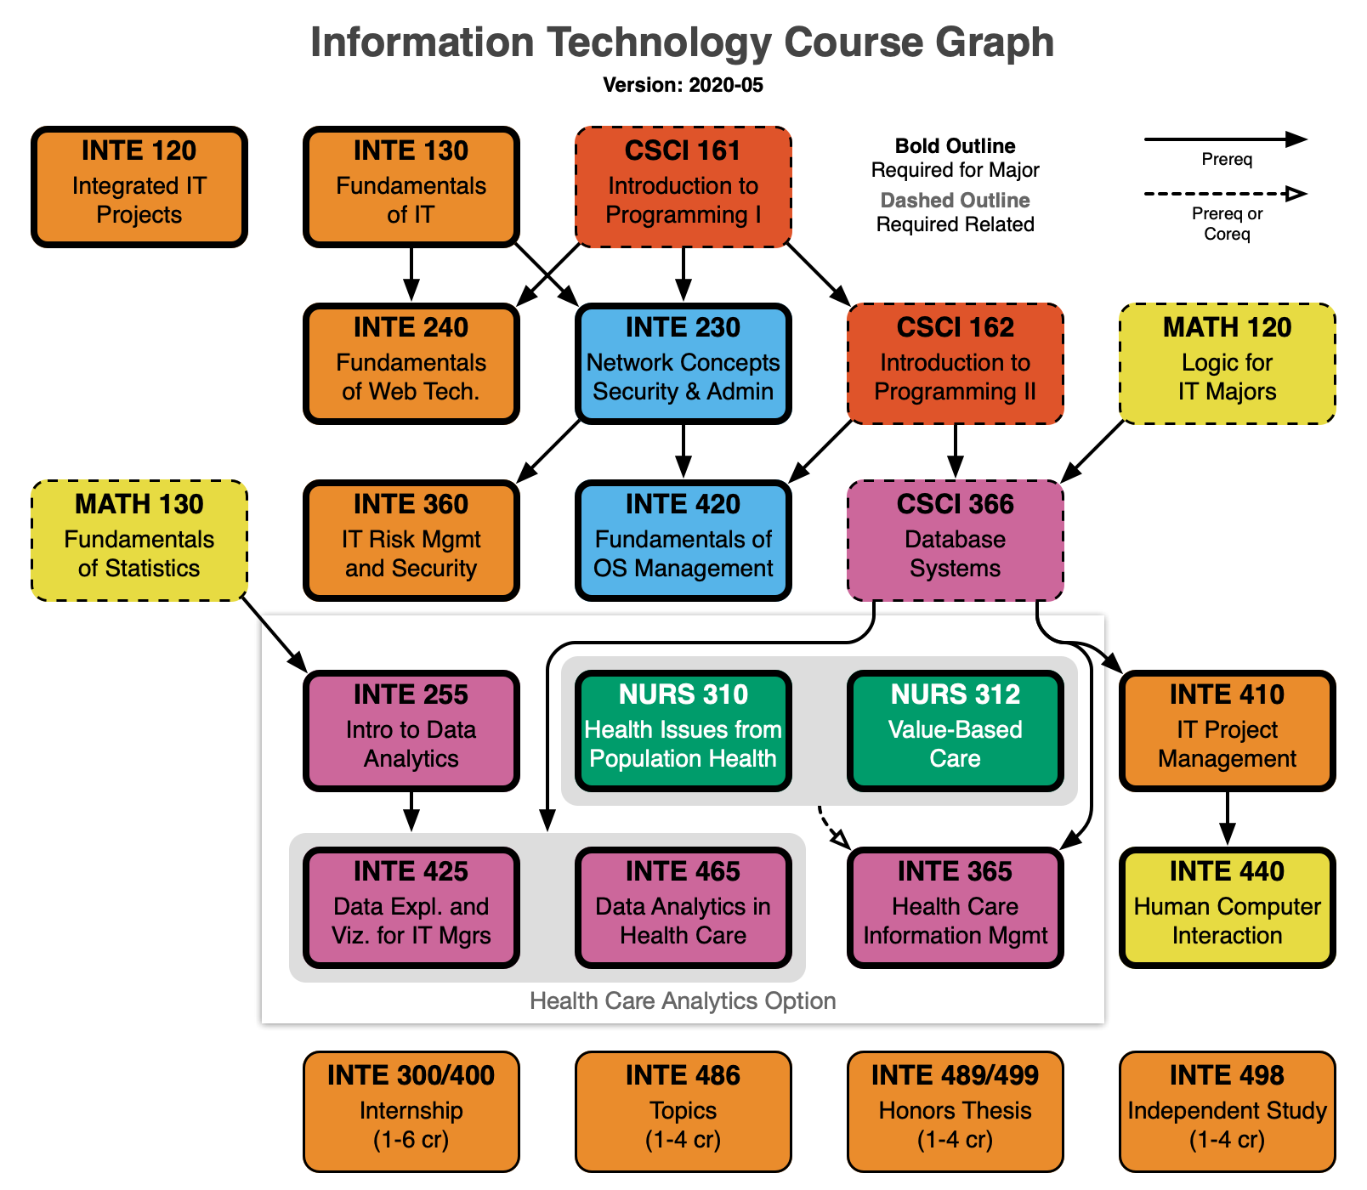
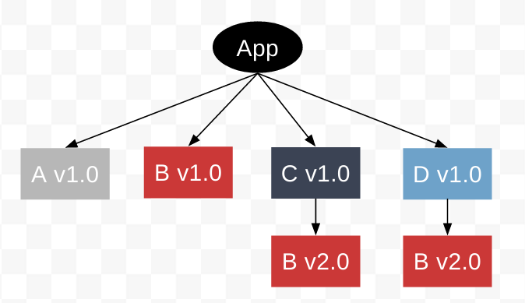
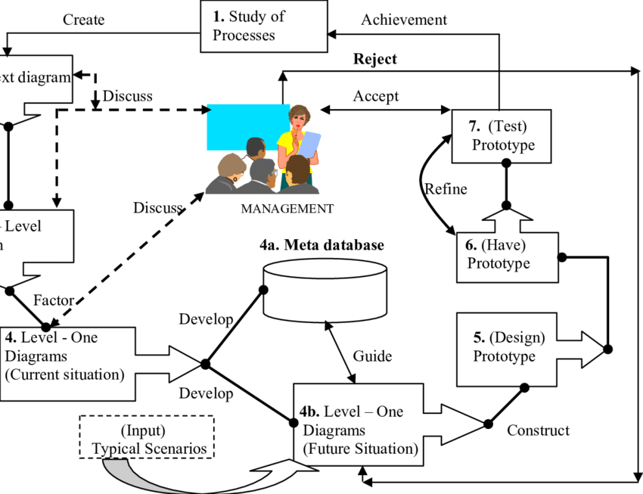
Topological Sorting
Applications
Course Prerequisites
Software Dependencies
Dataflow Analysis

Slide 40
Topological Sorting
Definition:
Sorting topologically means sorting so that for every directed edge uv, vertex u comes before vertex v in the ordering.
Notice:
Topological Sorting algorithms can only be used for directed acyclic graphs.

Slide 41
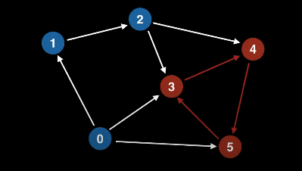
Topological Sorting

Slide 42
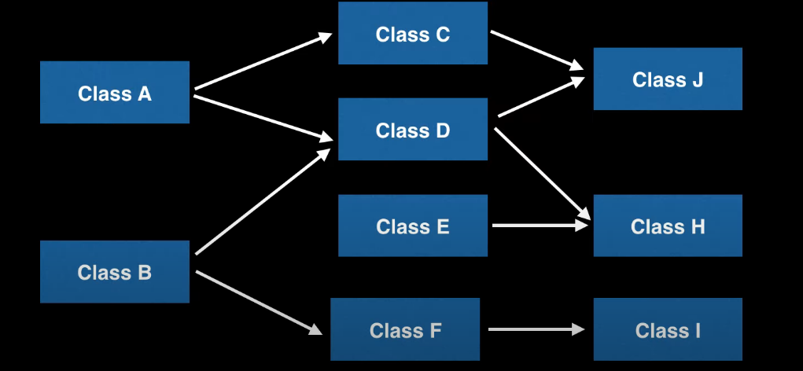
Topological Sorting

Slide 43
Topological Sorting
DFS-based Topological Sort
Steps:
Pick an unvisited vertex
Do a DFS, beginning with the selected vertex, exploring only the unvisited vertices
On the recursive call back of DFS, add that vertex to the ordering list

Slide 44
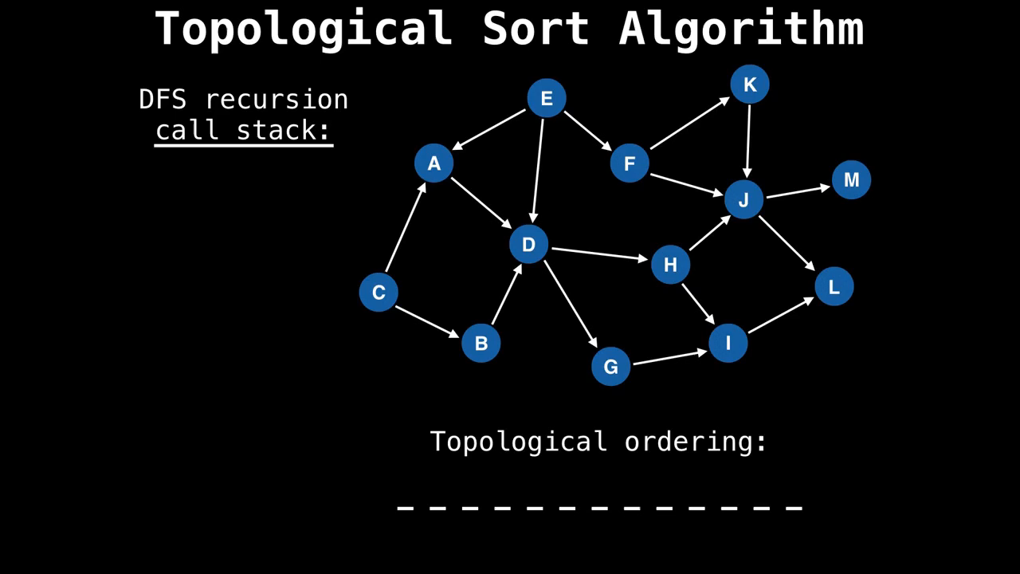

Slide 45
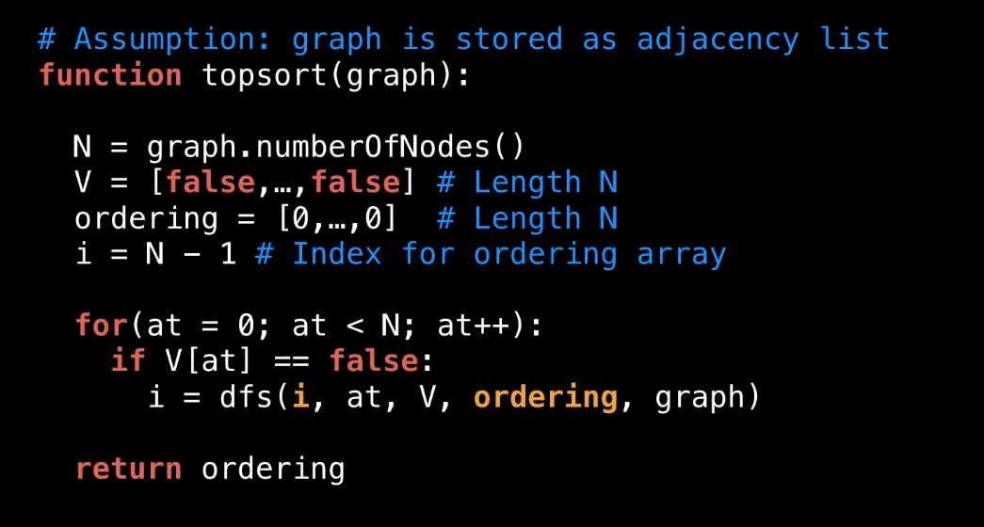
Topological Sorting

Slide 46
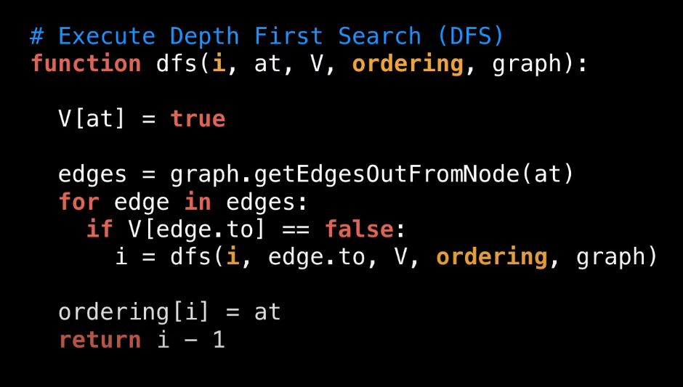
Topological Sorting

Slide 47
Topological Sorting
DFS-based Topological Sorting Algorithm's Complexity
Time Complexity
Essentially DFS so the time complexity is still O(V+E), where V is the number of nodes and E is the number of edges.
Space Complexity
O(V).

Slide 48
Topological Sorting
Advantages/Disadvantages:
Advantages
Efficient ordering.
Easy implementation using adjacency lists.
Wide range of applications.
Low time and space complexity.
Disadvantages
It only works on directed acyclic graphs (DAGs).
This does not provide a unique solution if there are multiple valid orders for the nodes.

Slide 49
Quiz

Slide 50
End
Thank You!

Slide 51
Shortest-path Algorithms
References:
J. A. Bondy and U. S. R. Murty, Graph Theory With Applications https://github.com/williamfiset/Algorithms/tree/master/slides/graphtheory
https://www.youtube.com/watch?v=4NQ3HnhyNfQ
https://www.geeksforgeeks.org/breadth-first-search-or-bfs-for-a-graph/
https://www.geeksforgeeks.org/depth-first-search-or-dfs-for-a-graph/
https://www.programiz.com/dsa/graph-dfs
https://www.programiz.com/dsa/graph-bfs
https://www.geeksforgeeks.org/difference-between-bfs-and-dfs/
Floyd-Warshall Algorithm (programiz.com)
Floyd Warshall Algorithm | DP-16 - GeeksforGeeks
Anany Levitin, Introduction to the Design and Analysis of Algorithms, 3rd Edition, 2014

